Slide 1

Let’s start with Allah Yaar
Bs in Computer Science

Slide 2
The Internet
Characteristics of the Internet
1. Global Network of Networks
The Internet connects millions of private, public, academic, business, and government networks worldwide.
Operates on standard protocols like TCP/IP, ensuring compatibility and seamless data exchange.

Slide 3
The Internet
2. Decentralized Structure
There is no central governing body; each network operates independently but interconnects through shared standards.
Decentralization ensures robust operation and availability despite localized failures.
3. Packet-Switched Communication
Data is divided into small packets that are routed independently through the most efficient paths.

Slide 4
The Internet
Enhances speed, reliability, and flexibility in communication.
3. Interactive and Multidimensional
Offers various modes of communication, such as text, audio, video, and multimedia.
Encourages interactive and real-time exchanges via platforms like video calls and messaging.
4. Unlimited Accessibility
Accessible through multiple devices such as PCs, smartphones, and IoT devices.
Offers resources for education, business, and entertainment at any time, from anywhere.

Slide 5
Uses of the Internet
1. Communication
Enables email, instant messaging, social media, video conferencing, and VoIP services.
Facilitates global collaboration and personal interactions.
2. Information Access
Provides vast resources for research, education, and news.
Search engines like Google and databases offer easy access to information.

Slide 6
Uses of the Internet
E-Commerce
Facilitates online shopping, banking, and financial transactions.
Businesses use it for advertising, sales, and customer support.
Entertainment
Offers streaming services for music, movies, games, and virtual reality experiences.
Social media and blogging platforms provide interactive engagement.

Slide 7
Uses of the Internet
Education and E-Learning
Supports online courses, virtual classrooms, and educational resources.
Expands learning opportunities for remote and lifelong education.
Remote Work
Enables telecommuting, project collaboration, and online productivity tools.
Increases flexibility for businesses and employees.

Slide 8
Uses of the Internet
Healthcare
Facilitates telemedicine, health monitoring, and access to medical information.
Supports online consultations and digital health records.

Slide 9
Advantages of Using the Internet
Global Connectivity
Bridges distances, enabling seamless communication worldwide.
Encourages cultural exchange and understanding.
Cost-Effective Communication
Lowers the cost of calls, messages, and collaboration compared to traditional methods.
Tools like email and VoIP save time and resources.

Slide 10
Advantages of Using the Internet
Unlimited Resources
Offers endless educational, professional, and entertainment materials.
Ensures continuous updates on global trends and innovations.
Business Growth
Expands market reach and provides tools for digital marketing and analytics.
Automates operations and enhances customer relations.

Slide 11
Advantages of Using the Internet
Convenience and Accessibility
Provides services like online shopping, banking, and utility payments.
Accessible 24/7, offering user-friendly platforms for diverse activities.
Enhanced Learning
Delivers innovative educational tools like interactive tutorials and simulation software.
Encourages self-paced and flexible learning models.

Slide 12
Disadvantages of Using the Internet
Privacy and Security Risks
Vulnerable to hacking, phishing, and data breaches.
May compromise sensitive personal or financial information.
Digital Divide
Unequal access due to socioeconomic or geographical barriers.
Creates disparities in opportunities and knowledge access.

Slide 13
Disadvantages of Using the Internet
Addiction and Overuse
Excessive use can lead to reduced productivity, mental health issues, and social isolation.
Overdependence on online activities impacts real-world interactions.
Spread of Misinformation
Facilitates rapid dissemination of false or misleading information.
Challenges credibility and fosters manipulation through fake news.

Slide 14
Disadvantages of Using the Internet
Cybercrime
Increases threats like identity theft, fraud, and cyberbullying.
Requires constant vigilance and advanced protective measures.
Environmental Impact
High energy consumption for servers and data centers contributes to carbon emissions.
The electronic waste from devices adds to environmental concerns.

Slide 15
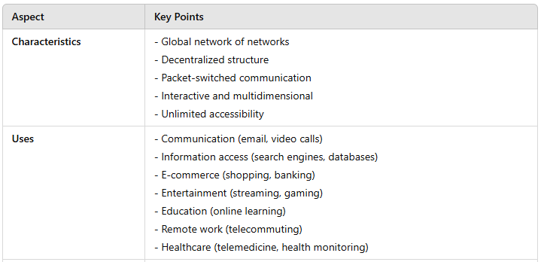
Summary Table

Slide 16
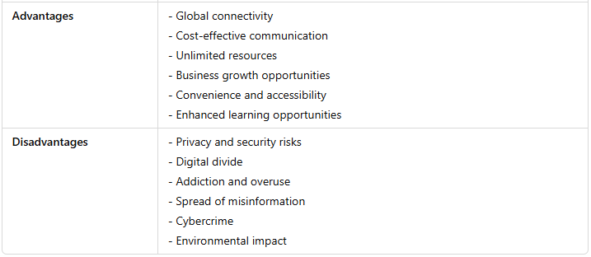
Summary Table

